Slide 1
Abstract algebra ch 27 symmetry groups

Slide 2
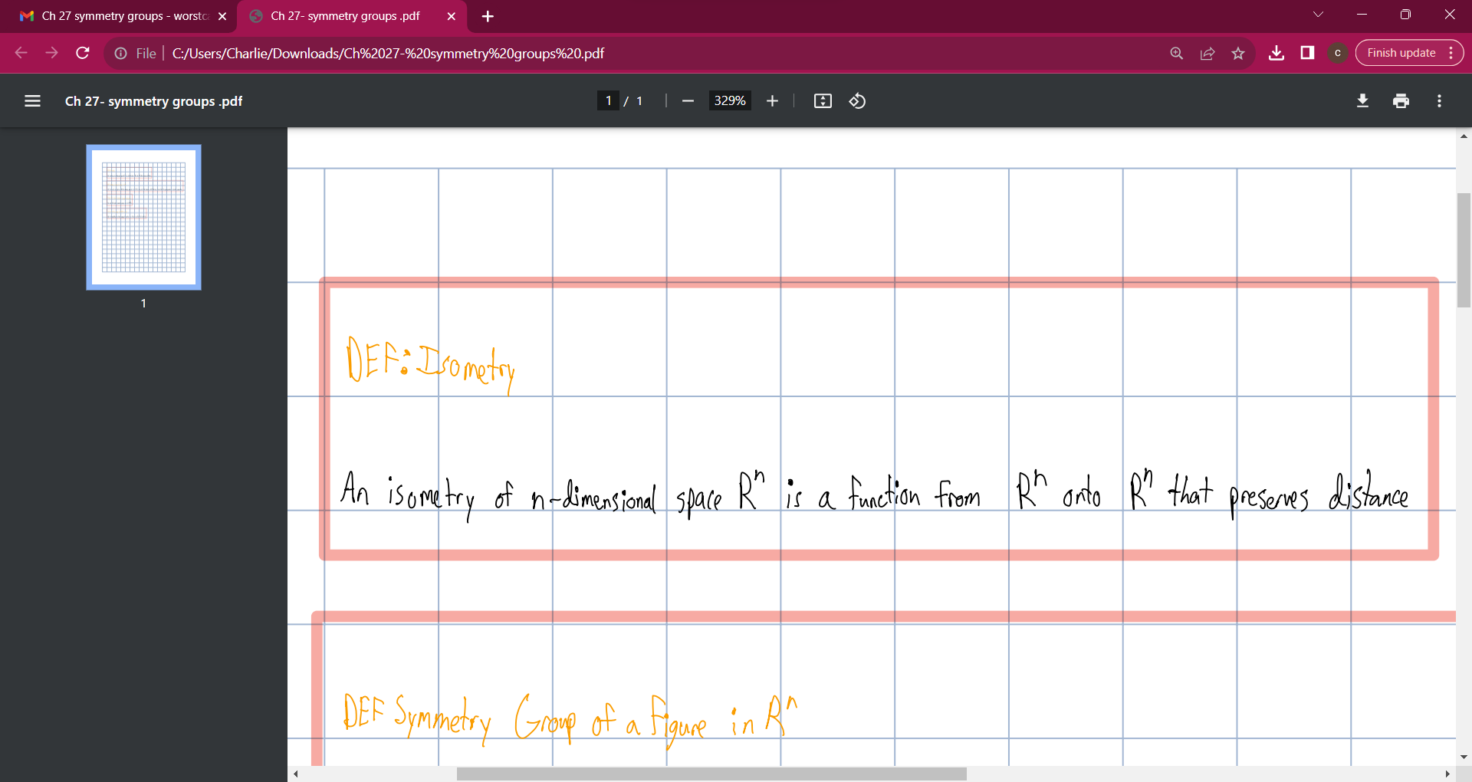

Slide 3
